Slide 1

Social Media for
Voice Actors

Slide 3
Social Media VO:
Surviving and Thriving in Social Media for your
VoiceOver Business
Trish Basanyi
Terry Daniel
Dave Courvoisier

Slide 4
Put away your pens
This PowerPoint Presentation including:
-Videos
-Links
-Tips
All available on:
http://www.socialmediavo.com

Slide 5
What we'll cover:
Twitter
Facebook
LinkedIn
Google +
Do's & Don'ts
Tips 'n' Tricks

Slide 6
What we'll cover:
Finding leads
Researching prospects
Social Media Branding
What to say
Managing your time
New trends

Slide 7
Also:
Google +
G+ Hangouts and HIRLs
Pinterest
Cross-posting
Automated Posting

Slide 8



Terry Daniel: Facebook
Trish Basanyi.
Twitter
Dave Courvoisier
LinkedIn

Slide 9
TERRY DANIEL

Slide 10
FaceBook
The Greatest Party in the World!!!
Do’s
Stay positive
Friend other Voice Talent
Mix business-related status updates with personal
People need to know you’re human!!!

Slide 11
FaceBook
The Greatest Party in the World!!!
Don’ts
Avoid arguing back ‘n’ forth
Don’t tag people on pics without permission
Don’t spam people’s walls with links to your stuff
Don’t send mass private messages
Don’t overpost

Slide 12

Add Like and recommend buttons on your website.
This is how to get website visitors to advertise
FOR YOU
on FaceBook!

Slide 13
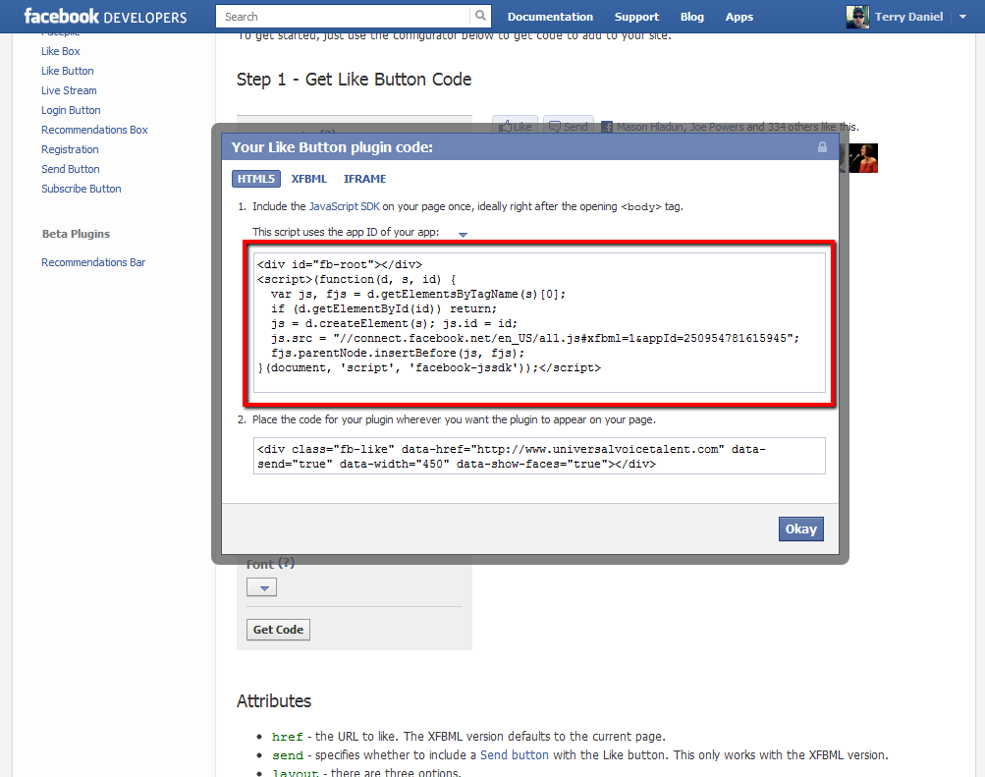

Slide 14
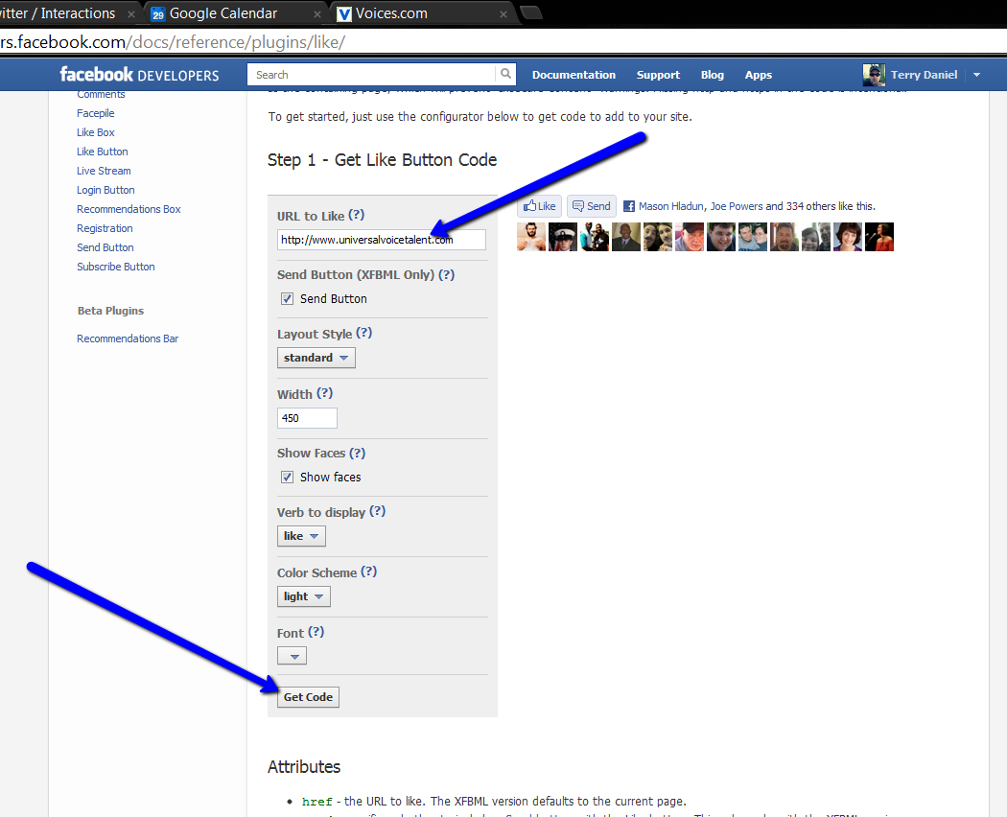

Slide 15

FaceBook TimeLine
is a
MONSTER

Slide 16
BUILDING AN EFFECTIVE
BRAND PAGE
Give people a reason to become fans
Stay on topic
People who like your brand on FB, expect your posts to
be at least somewhat related to your VO business

Slide 17
Include pictures in your FB
updates, This always draws more
attention than just writing a status
update
Write about a current event and tie it to your brand
Ask your audience to post questions
Celebrate your milestones
Find and share a funny YouTube Video
Run a FaceBook Contest

Slide 18
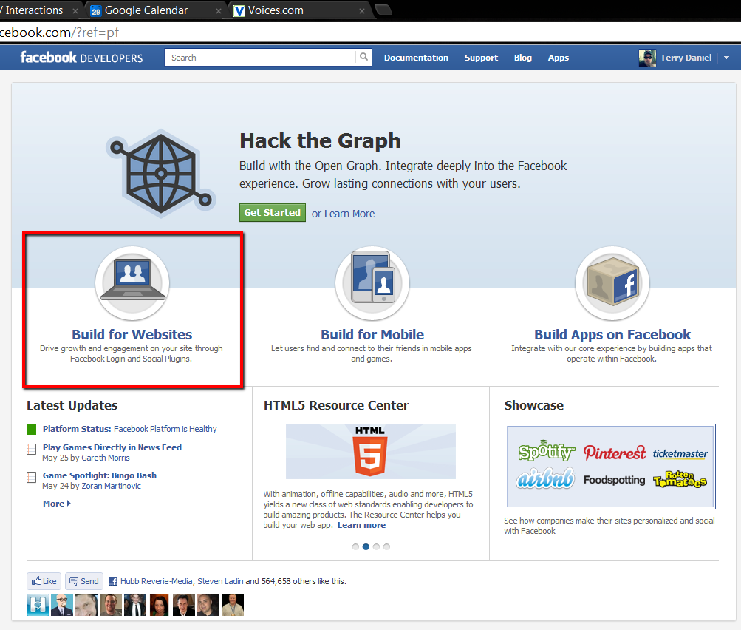

Slide 19

SOUNDCLOUD
The perfect social site
for Voice Actors
Post your demos
Audio clips of cool projects you are working on.
Podcasts.
Follow others in the creative industry.
Post to Facebook and Twitter automatically!
Record right on SoundCloud!

Slide 20
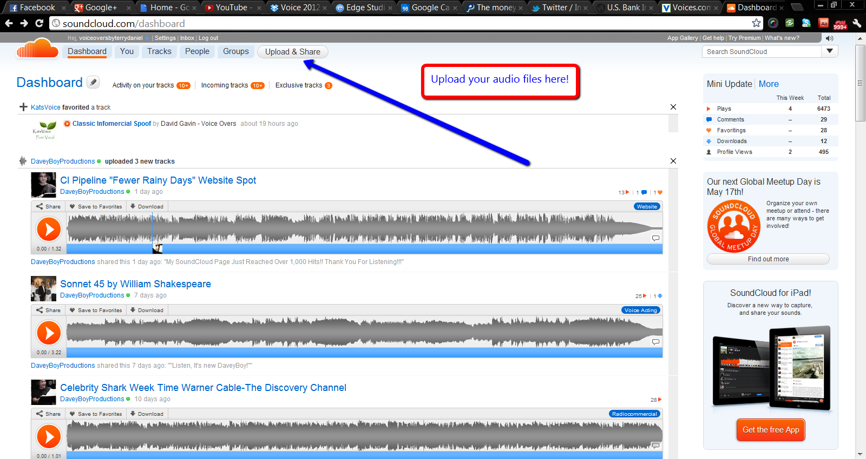
SOUNDCLOUD

Slide 21
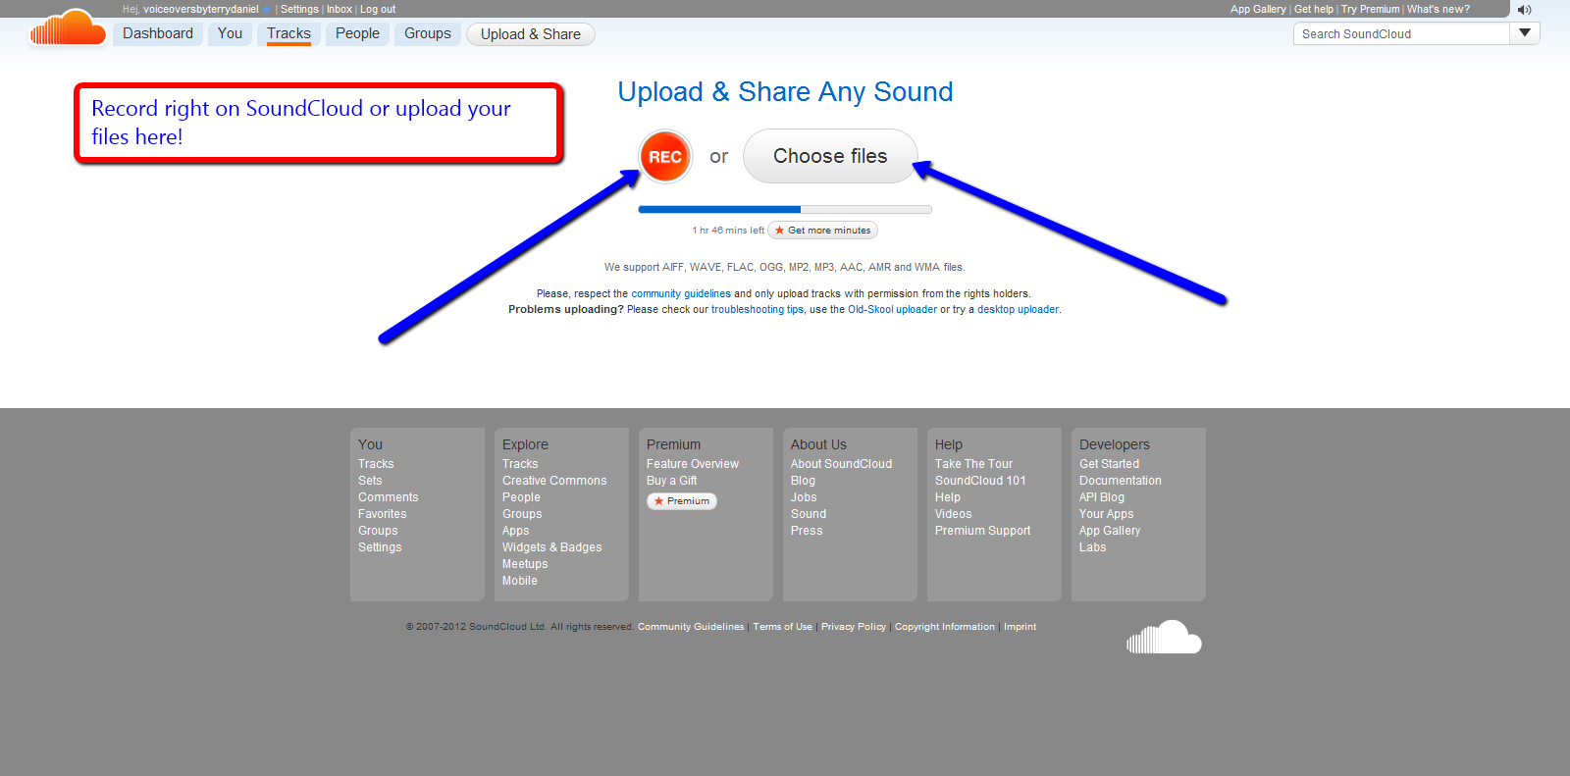
SOUNDCLOUD

Slide 22
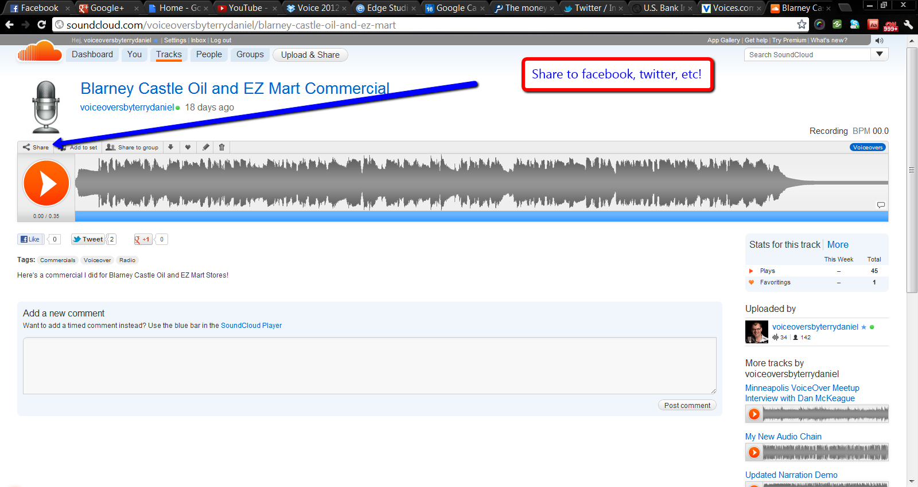
SOUNDCLOUD

Slide 23
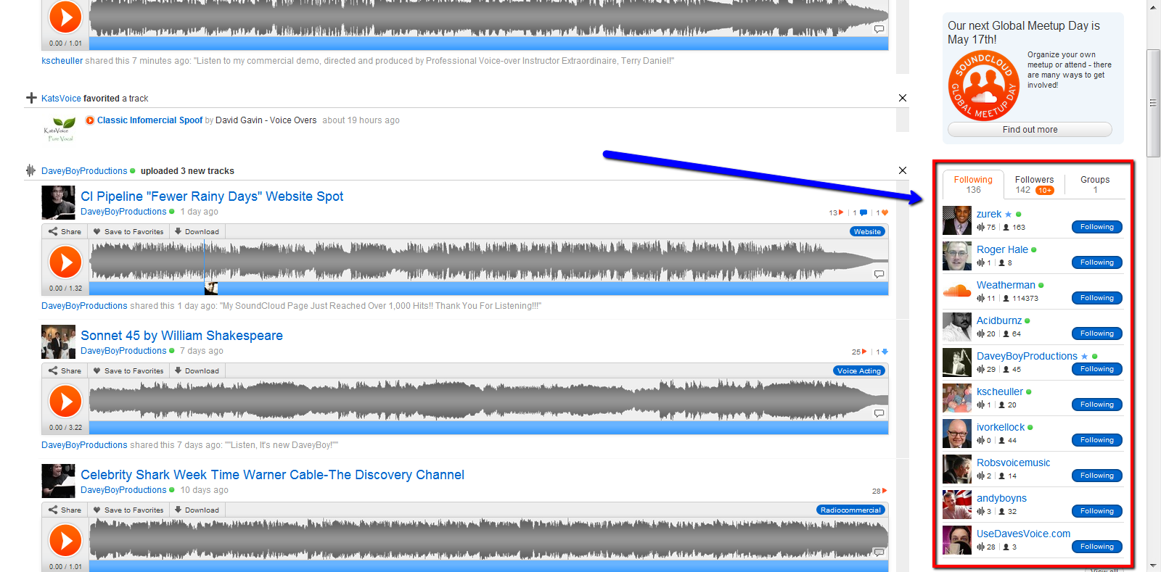
SOUNDCLOUD

Slide 25
TRISH BASANYI

Slide 26

The Twitter Relationship
140 characters, that’s it! It’s a simple concept. People fear it but it’s not hard once you get started.
Think of Twitter as going to a party. It’s a 2 way street! Start conversations.
Create relationships, listen to people!
Be patient
Say “Thanks” a lot!
Have fun!

Slide 27


What to tweet?
Anything interactive….no “commercials”. Asking questions is a great way to start a conversation.
Hashtags (#voiceover, #voiceovers, #voicetalent are most popular, usually at the end of tweets)
No repeats, keep in mind that people can see your page (all your outgoing tweets!) If it’s the same tweet all the time, people get turned off. Even if it means tweeting LESS, don’t do automated tweets. Go organic! ☺
Polls

Slide 28
What to tweet? (cont’d)
Business as well as some personal, about a 70/30 split.
RT’s (Retweets) – important or interesting info you see, or to get a client’s attention RT something interesting or funny they tweeted
Use “buzz” words to grab attention at the beginning of a tweet “wow!” or “w00t!” “amazing!” “crazy!” “Yay!” On the other hand also use dry humor…..if people see too many exclamation points they’ll find it spammy. (i.e. My dog just ate my script. Greaaaat.)

Slide 29

Twitter Apps/Tools
Twellow.com:
Biography Search
Register your own profile
Search for job titles of people that hire voice talent (creative director, commercial producer)
Search local potential clients by using the Twellowhood tab
TweetDeck.com
(Manages tweets in one view)
Standalone app on your desktop
Create custom search columns
search phrases that someone would use if they were searching for a voice talent

Slide 30
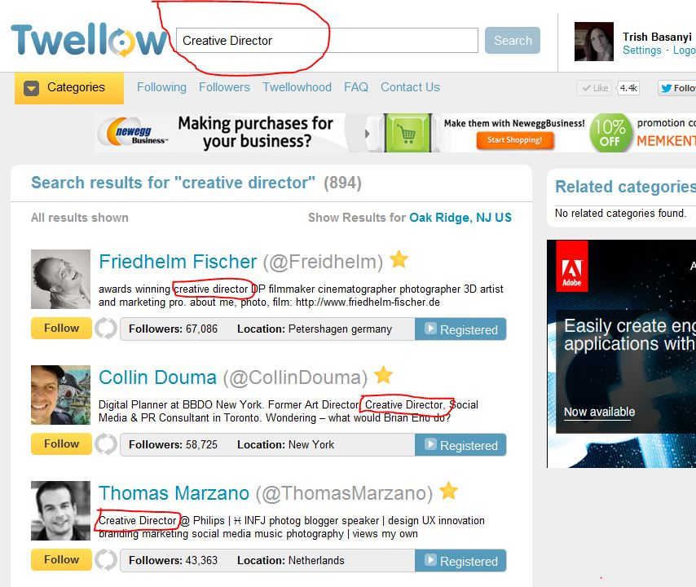

Slide 31
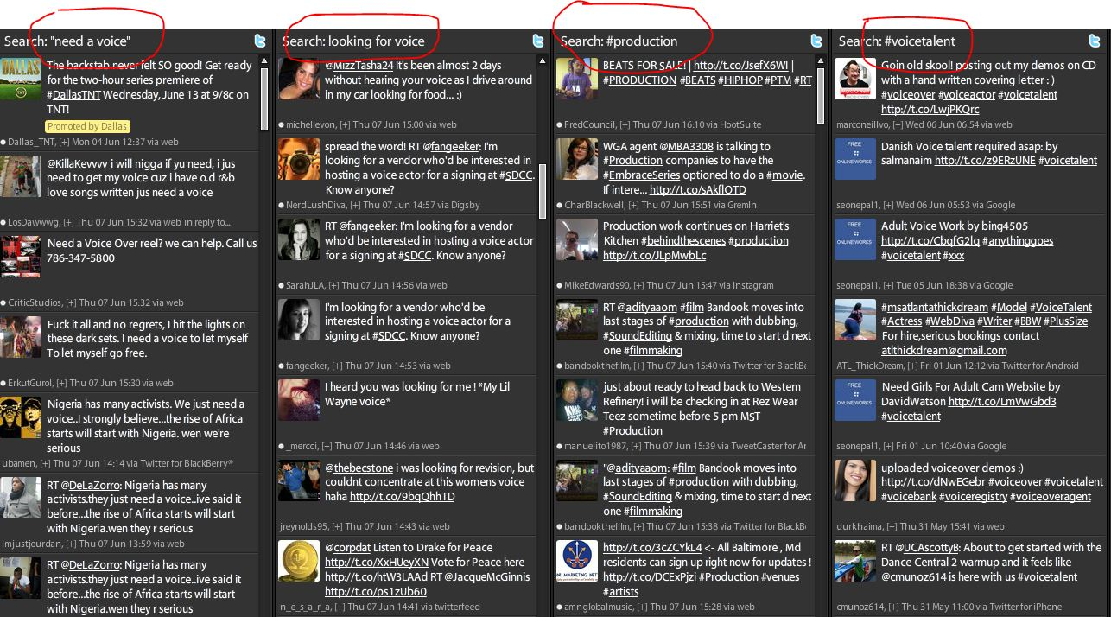

Slide 32
Your Profile
Pic of YOU, not your logo
Mix it up: Tweets, replies, and RT’s
Your OWN website’s url (pay-to-play profile links make you look like an amateur)
Spend a little time on the background design of you profile page

Slide 33
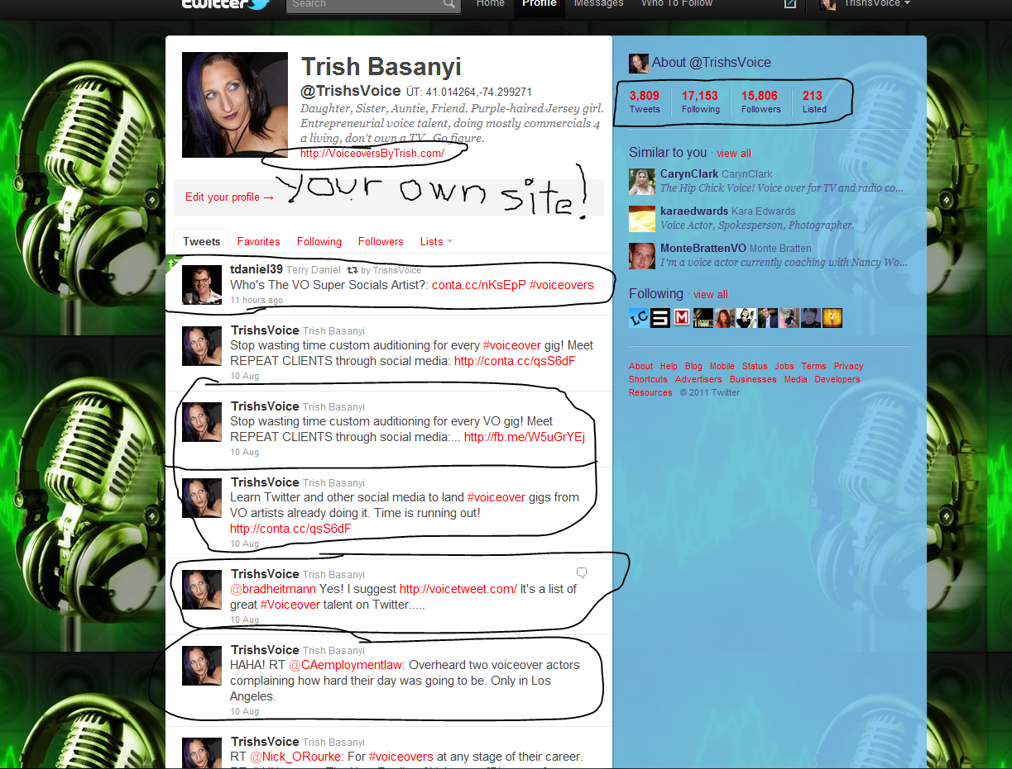

Slide 34
Lists
Make your own to help group the people you follow
Getting listed on someone else’s list is GOOD
You can follow whole lists if you have a particular interest
Add your own list to search engines or look for other lists on Listorious.com

Slide 35
Hashtags (#)
Simply a way of grouping categories and interests. They look intimidating but (like Twitter) are a very simple concept! Again, look at what other folks are using and follow suit. Always feel free to go to my page at any given time: (http://twitter.com/TrishsVoice) for inspiration and examples.

Slide 36
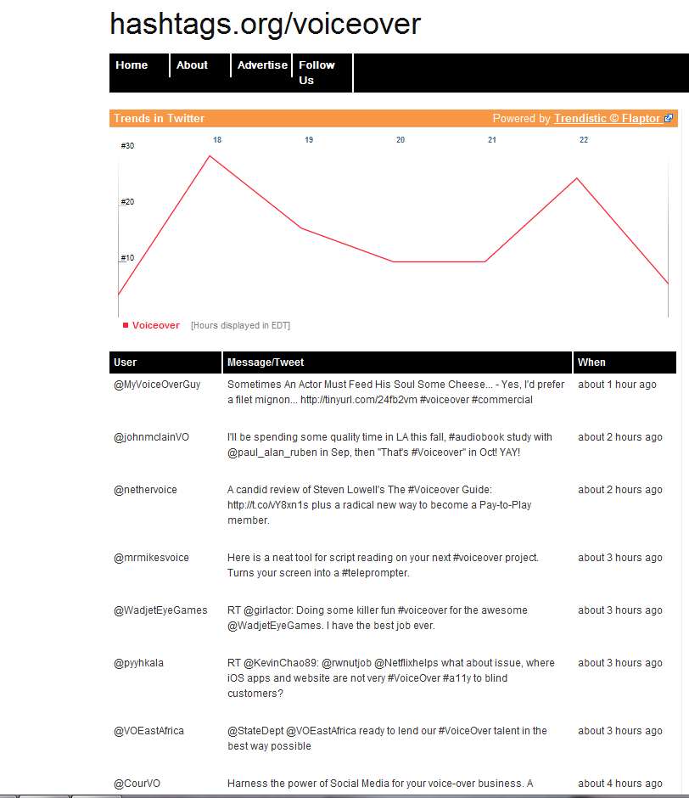
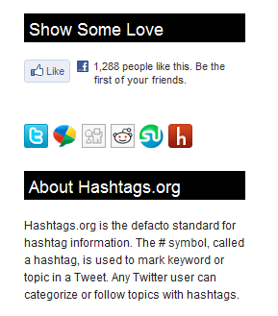
Hashtag.org

Slide 37
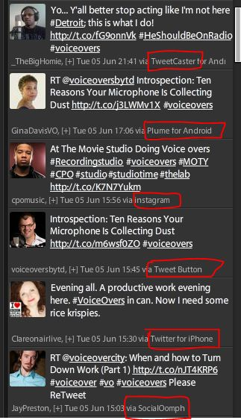
Keep your eyes open on what programs and apps others are using to post updates, there are always new tools being developed and what I’m showing here is just the beginning. Try different things and see what works for you!

Slide 38
Getting in there and trying it is the best way to learn. I wasn’t a pro at this when I first started either; I learned as I went! Try one thing at a time or you’ll get overwhelmed. Remember, the key is for it to be FUN!
If you’re not having fun, it’s ok to decide NOT to do this. It’s only going to be effective if you ENJOY it.

Slide 39

Some Final Thoughts
If you want to learn how to do something new, or learn more about it, GOOGLE IT!
Search in videos on the web and chances are there is a 2-3 minute video explaining it in detail, with on-screen instructions. This includes any apps or features.

Slide 40

Now that you know how, follow us!
@VOSuperSocials
Individual Twitter ID’s
TRISH: @TrishsVoice
DAVE: @CourVO
TERRY: @VoiceoversByTD

Slide 41
Dave Courvoisier
LinkedIn
YouTube
Google Plus
Pinterest
Blogging

Slide 42
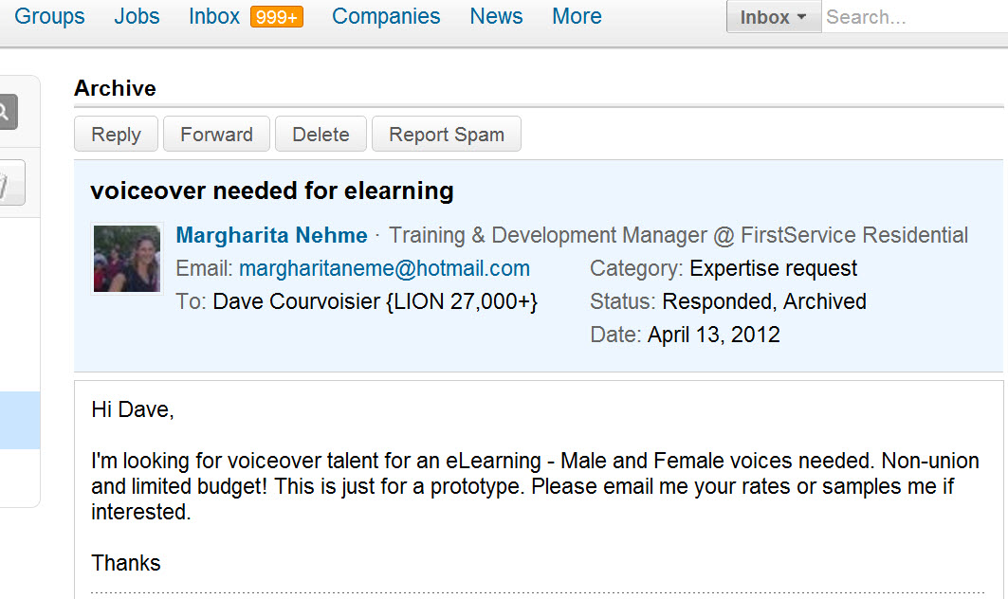
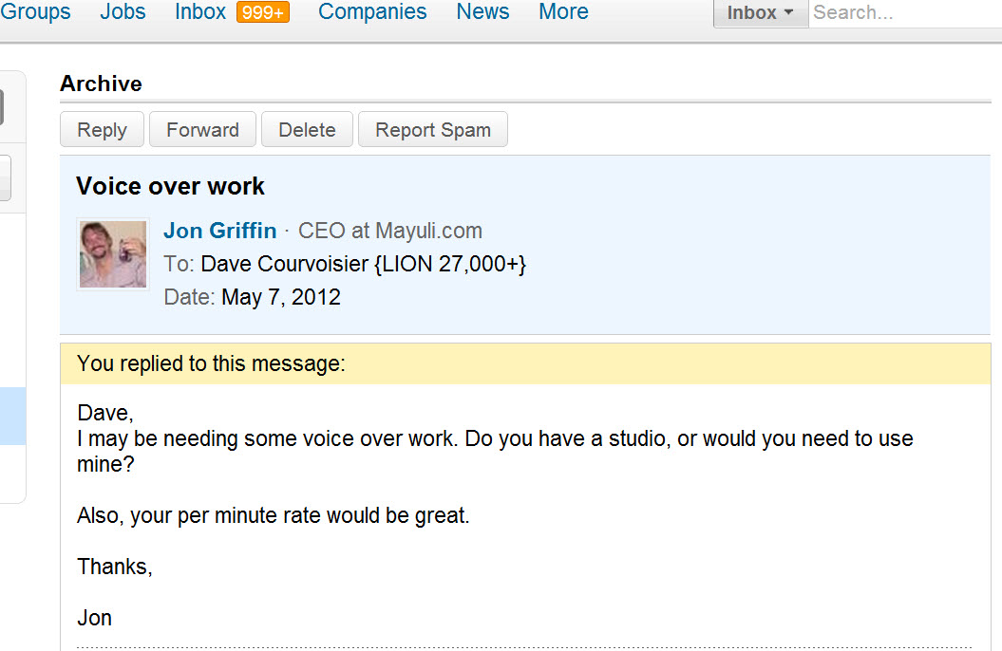
It Works…!!!

Slide 43

160-Million Members
650,000+ groups
Business Network
Free or Tiered pay plan
Profile Intensive
Recommendations
Apps: http://www.linkedin.com/static?key=application_directory&trk=hb_side_apps
Integrated with other Social Media

Slide 44
PROFILE
Include a picture
Complete your profile to 100%
Choose your words carefully
Seek recommendations
Give recommendations
Add apps
  Box.net
  Social Media cross-posts

Slide 45
SEARCH
THIS IS THE SINGLE-MOST IMPORTANT FEATURE THAT SETS LINKEDIN APART FROM IT’S COMPETITORS!!!
PARAMETERS:
Name
Region
Industry
Relationship
Connections

Slide 46
GROUPS
USE GROUPS TO MEET PEOPLE NOT IN YOUR IMMEDIATE 1st-order CONNECTIONS
650,000 groups
Join up to 50
Start your own group
Visit, contribute, start discussions
Form relationships

Slide 47
GROUPS
PROMINENT
VOICE-OVER GROUPS:
Ed Victor’s
“Working Voice Actor Group” (3000)
Lee Gordon’s
Voice Over Professionals (4800+)
Dave Courvoisier’s
“Setting Voice-Over Rates
Dave Courvoisier’s
“Social Media for Voice Actors”

Slide 48
TIPS
Join groups that might be populated with people who could be in the business of hiring you:
E-learning groups
Audio Production Types
AudioBook Publishers
Post all your demos through the Box.net app on LinkedIn.

Slide 49
YouTube
2nd most-used Search engine in the world
(….and yes, Google owns this one, too!)
Stats 20 hours of video uploaded every minute
Create your own Channel
http://www.oncamtips.com
Bill DeWees Voiceovers

Slide 50
YouTube
YouTube is also hands-down the best place to hear how to pronounce a word that you may have come across in your work. A search for that word will usually lead to a video where the word is pronounced.
Caution: YT is also the biggest time-suck of the social media platforms, so go in with an agenda, and don’t get caught wasting time!

Slide 51
YouTube
Compose a video presentation to go with your demo on YouTube
link to it
share it
email it
post on FaceBook
post it on Twitter
post it on LinkedIn
link it to your Website
load it on your blog

Slide 52

Google Plus (G+)
FaceBook Challenger?
Previous failures:
Google Wave
Google Buzz
Helps to have: Chrome Browser
Google Gmail account

Slide 53
Google Plus (G+)
Its allure lies in the potential for G+
to tie into a HUGE family of Google products:
Docs, Calendar, Gmail, Search, Chrome,
Reader, etc.,
(not to mention the users of all those products)

Slide 54
Google Plus (G+)
Circles
Hangouts
Huddles
Sparks
Timeline
Instant Upload (Android device)
Games
(my fave: you can edit an entry, or choose whether you even want someone to comment on it)

Slide 55
Google Plus (G+)
YOUR NAME
BUSINESS ACCOUNTS and PAGES
Add-ons, plug-ins, extensions galore
New: Games (no Farmville!)

Slide 56
Google Plus (G+)
HANGOUTS
Instantaneously video
conference with up to 10 people at once.
HUDDLES
This is basically Google Chat. You get to invite, accept, join, and reject people for your chat as you please.
SPARKS
Focus on areas of your interest. Google suggests topics, but
you can search for your favorites.

Slide 57
PINTEREST
Exploding growth if this site is getting everyone’s attention.
It’s a PinBoard, where you post stuff that interests you, re-pin stuff others have posted, and comment, create relationships, and follow/be followed like other sites.
Notable: this site is predominantly female-oriented and populated…at least it was at first. Advertisers, and particularly visually-oriented content is hot.
You can create categories of topic interest, and fill those categories with things that pertain to that topic.

Slide 58
PINTEREST
Since it’s so visual, this site serves your logo and branding materials well.
This is a site to watch for huge growth potential, and in my estimation, should not be ignored.
Be sure to fill out your profile fully, and whether you like it or not, provide a picture.
Important: install the bookmarklet, so while you’re browsing, you can easily “Pin” stuff to your page that interests you, and hopefully others.

Slide 59
Presenter Effectiveness

Slide 60
Questions, Suggestions, Comments, or Concerns?
http://www.SocialVO.com

